Slide 1
Blood4Life Final Presentation
The Team:
Madhubala Ganesan, Ahmed Afif Monrat
Tanguy Feuillet, Xhesika Ruci, Syed Asif Iqbal

Slide 2




Brainstorming!

Slide 3

Eureka!
Disaster Management?
Solve real world problems with crowd sourcing
Building a resilient community?
Usefulness of the idea

Slide 4
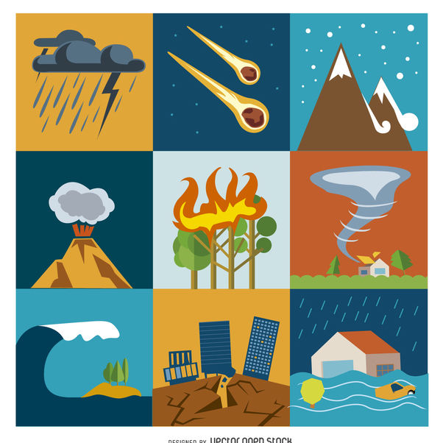

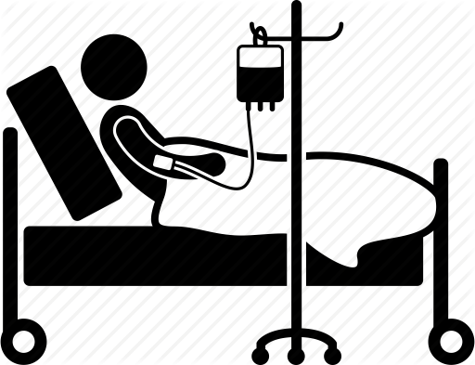
What is the problem?

Slide 5


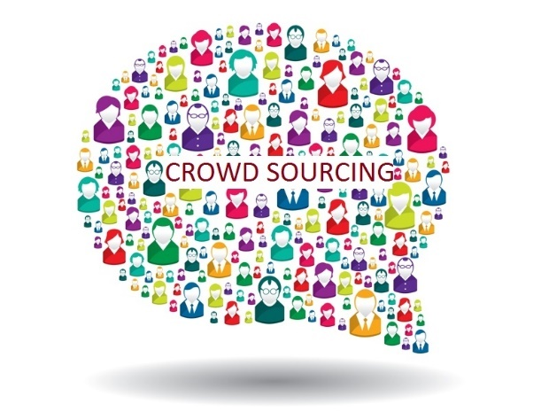
What is the Solution?
WWF Theme: Governance and Citizenship
Stewardship in citizens
Hospitals and Blood banks – a part of Governance
People are integral to the sustainability of blood supply
A Community of Blood Donors
Blood donation as a social responsibility and cornerstone of a resilient community

Slide 6
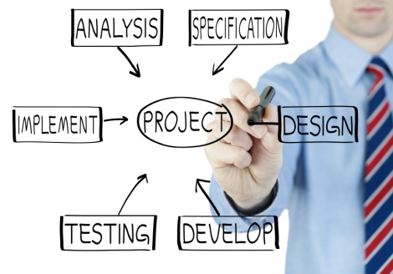
Blood4Life
The aim is to develop an application serving as the crowdsourcing platform for our reforming idea to the blood donation system in Finland

Slide 7


Slide 8
Project Planning
1

Slide 9
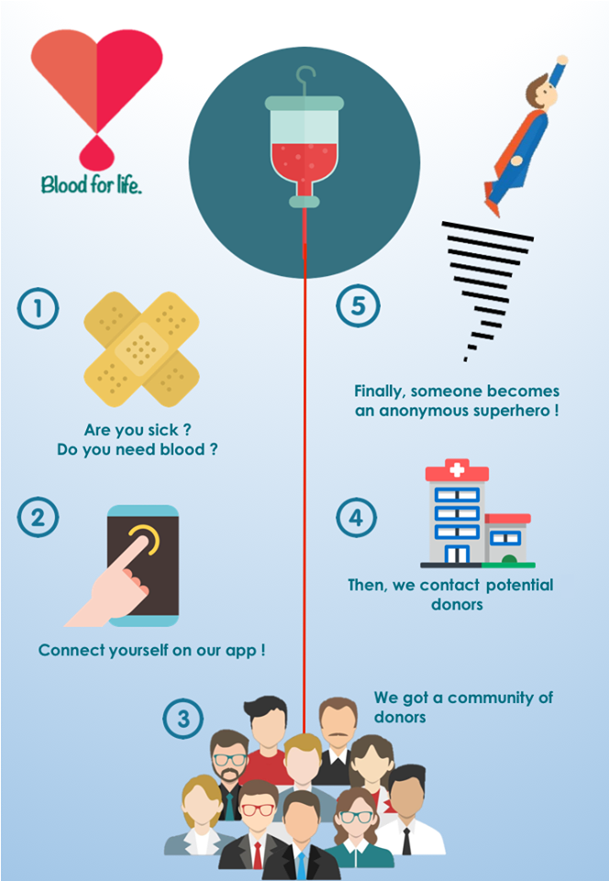
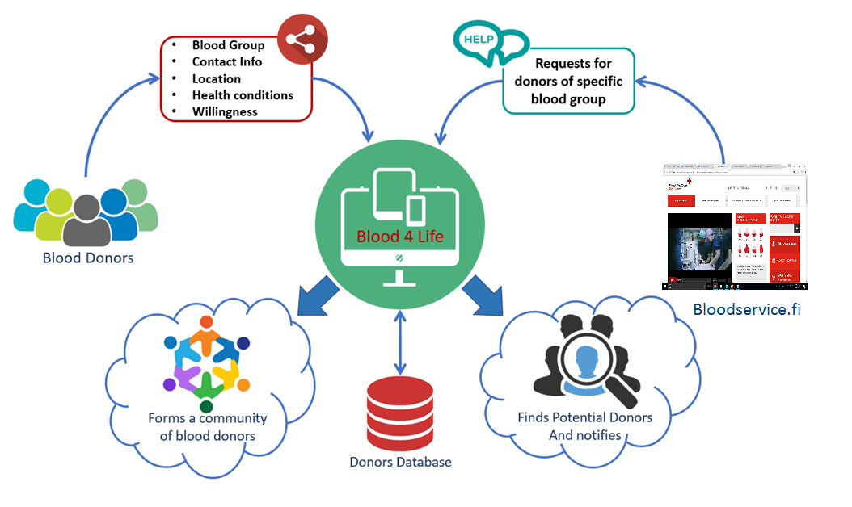
Refining the Idea!

Slide 10

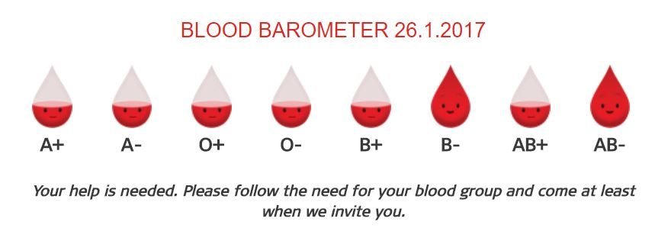
Blood Barometer

Slide 11



Defining the process
Defining the Roles and Responsibilities
Defining the process timeline
Defining the requirements and solution qualities

Slide 12
Usability Design
2
The process of enhancing user satisfaction with a product by improving the usability and accessibility provided in the interaction with the product.

Slide 13
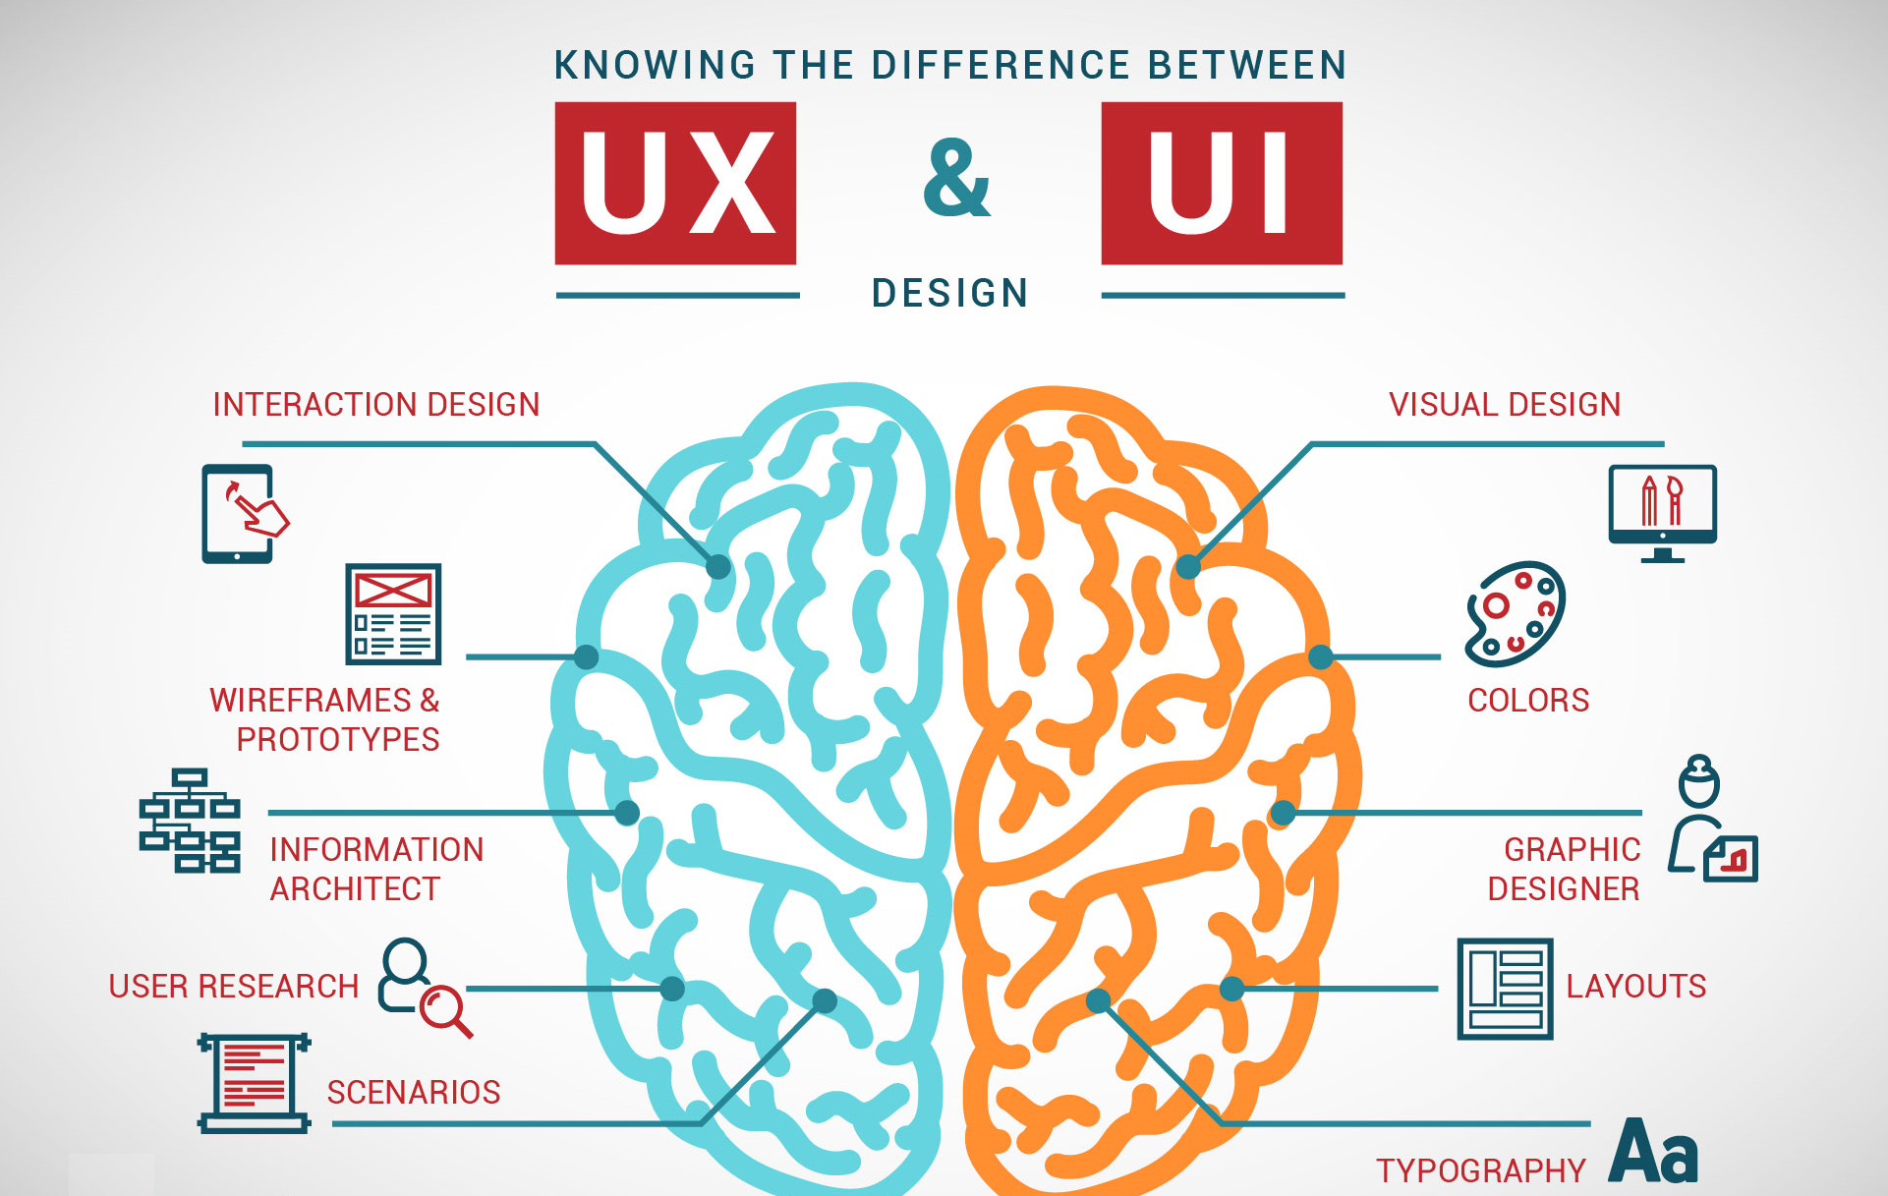
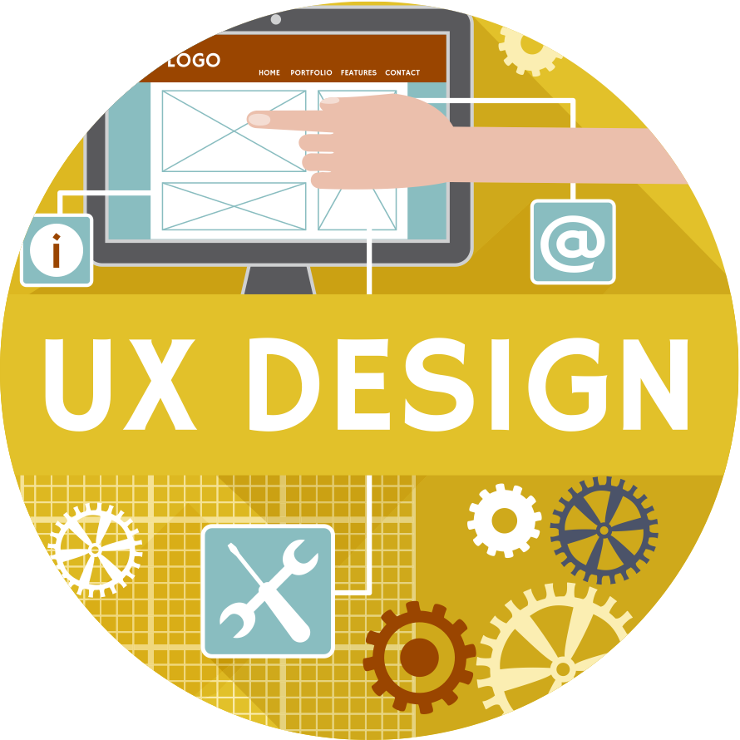
Understanding User Expectations!

Slide 14

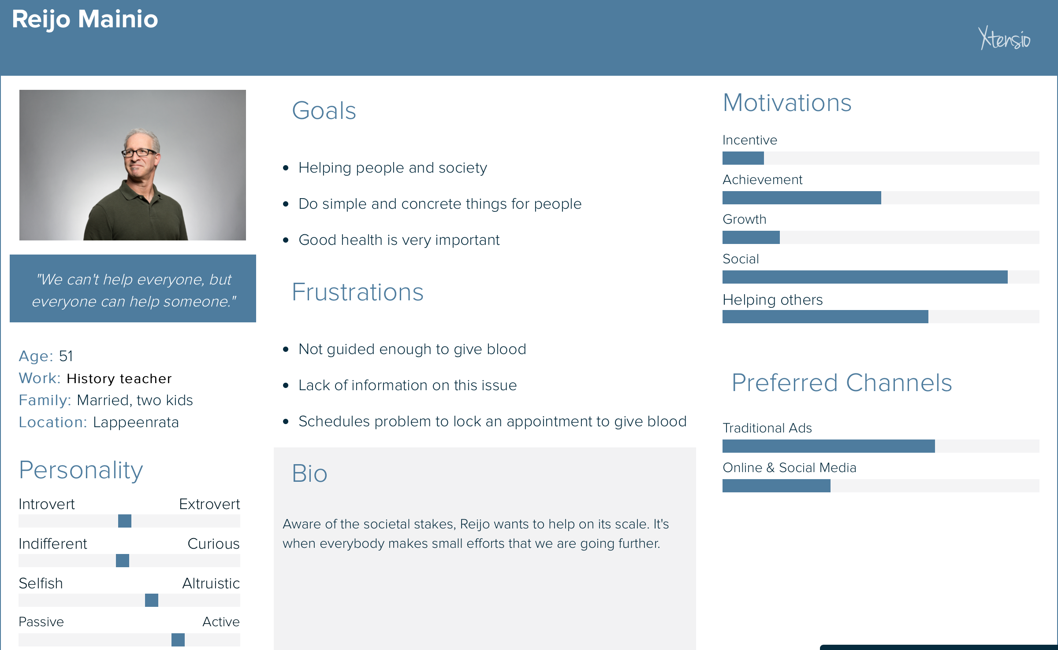
User Analysis!
Julia is a young student. Of a simple and altruistic nature, she loves to help others naturally. She lives a simple life and is a relationship for 3 years. Julia hates the unexpected and is easily stressed by it.
She supports all initiatives which are in the direction of social progress. A little idealistic, she likes values like sharing, fraternity and mutual help.
Since her childhood, she has a rare form of anaemia that requires regular blood transfusions. Thus, she finds Blood4life to be very useful and encourages this initiative.
Stakeholders
Direct
Blood Donors
Finnish Red Cross (Blood Banks)
Indirect
People who need blood

Slide 15
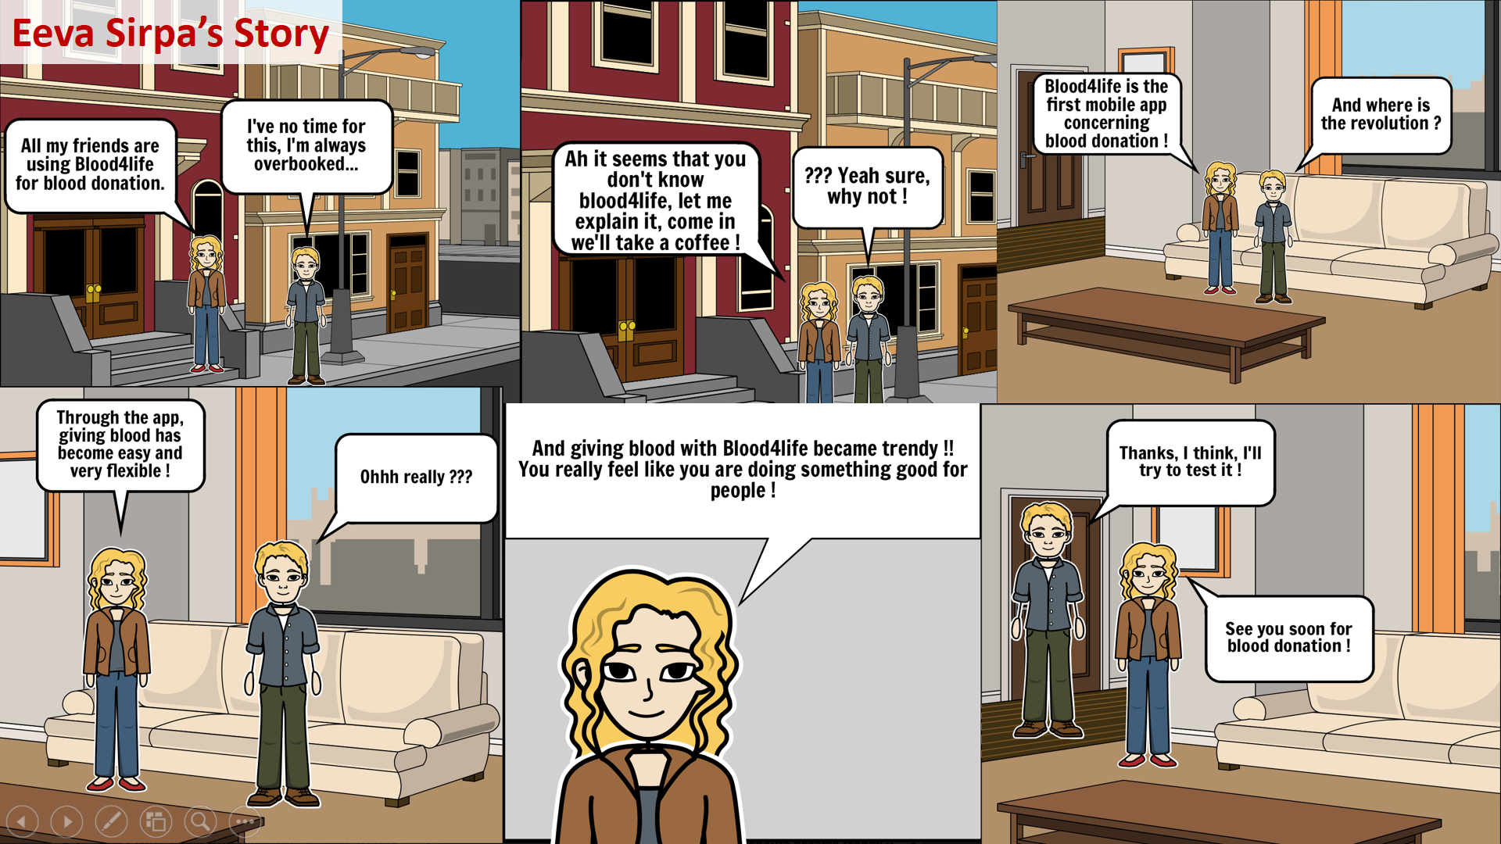
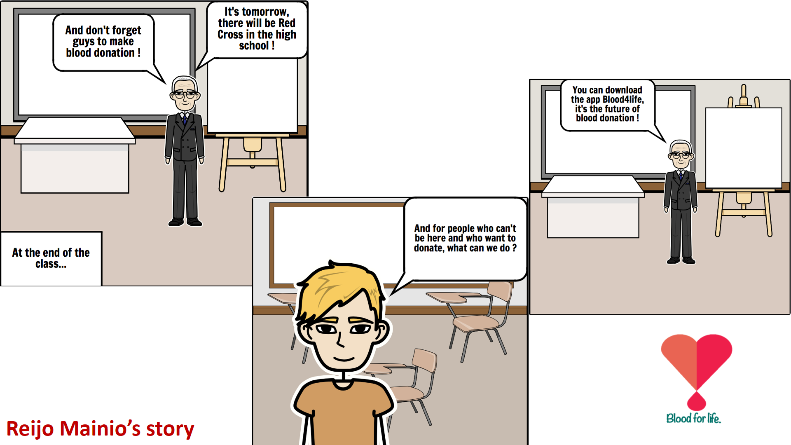
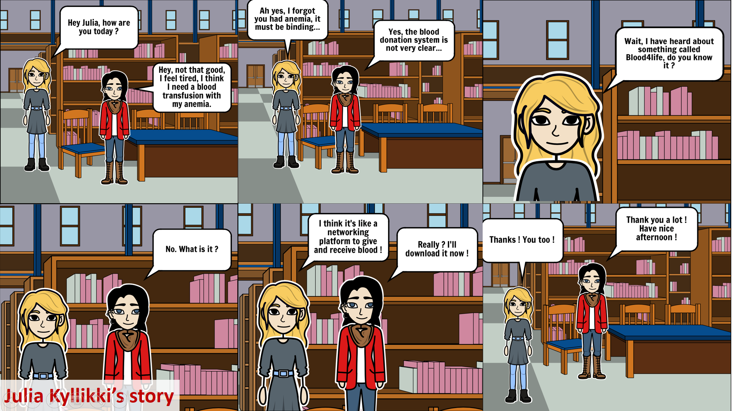
Story Boarding

Slide 16
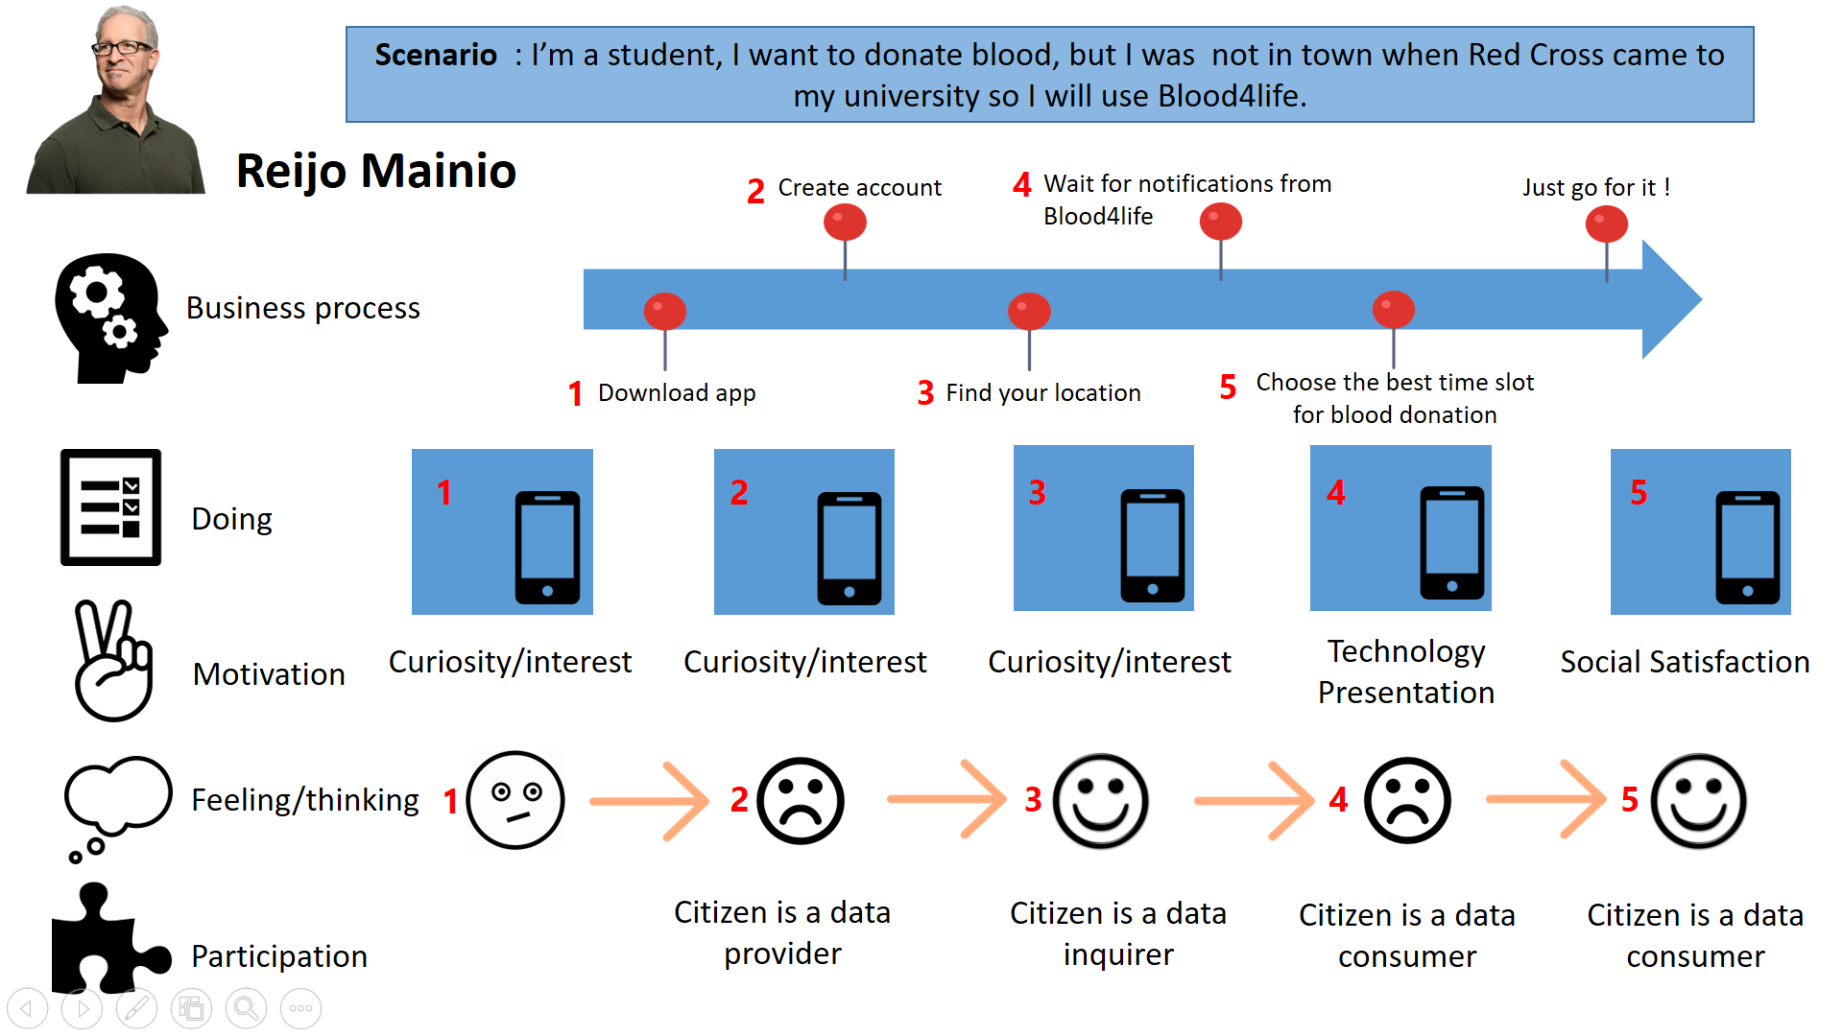
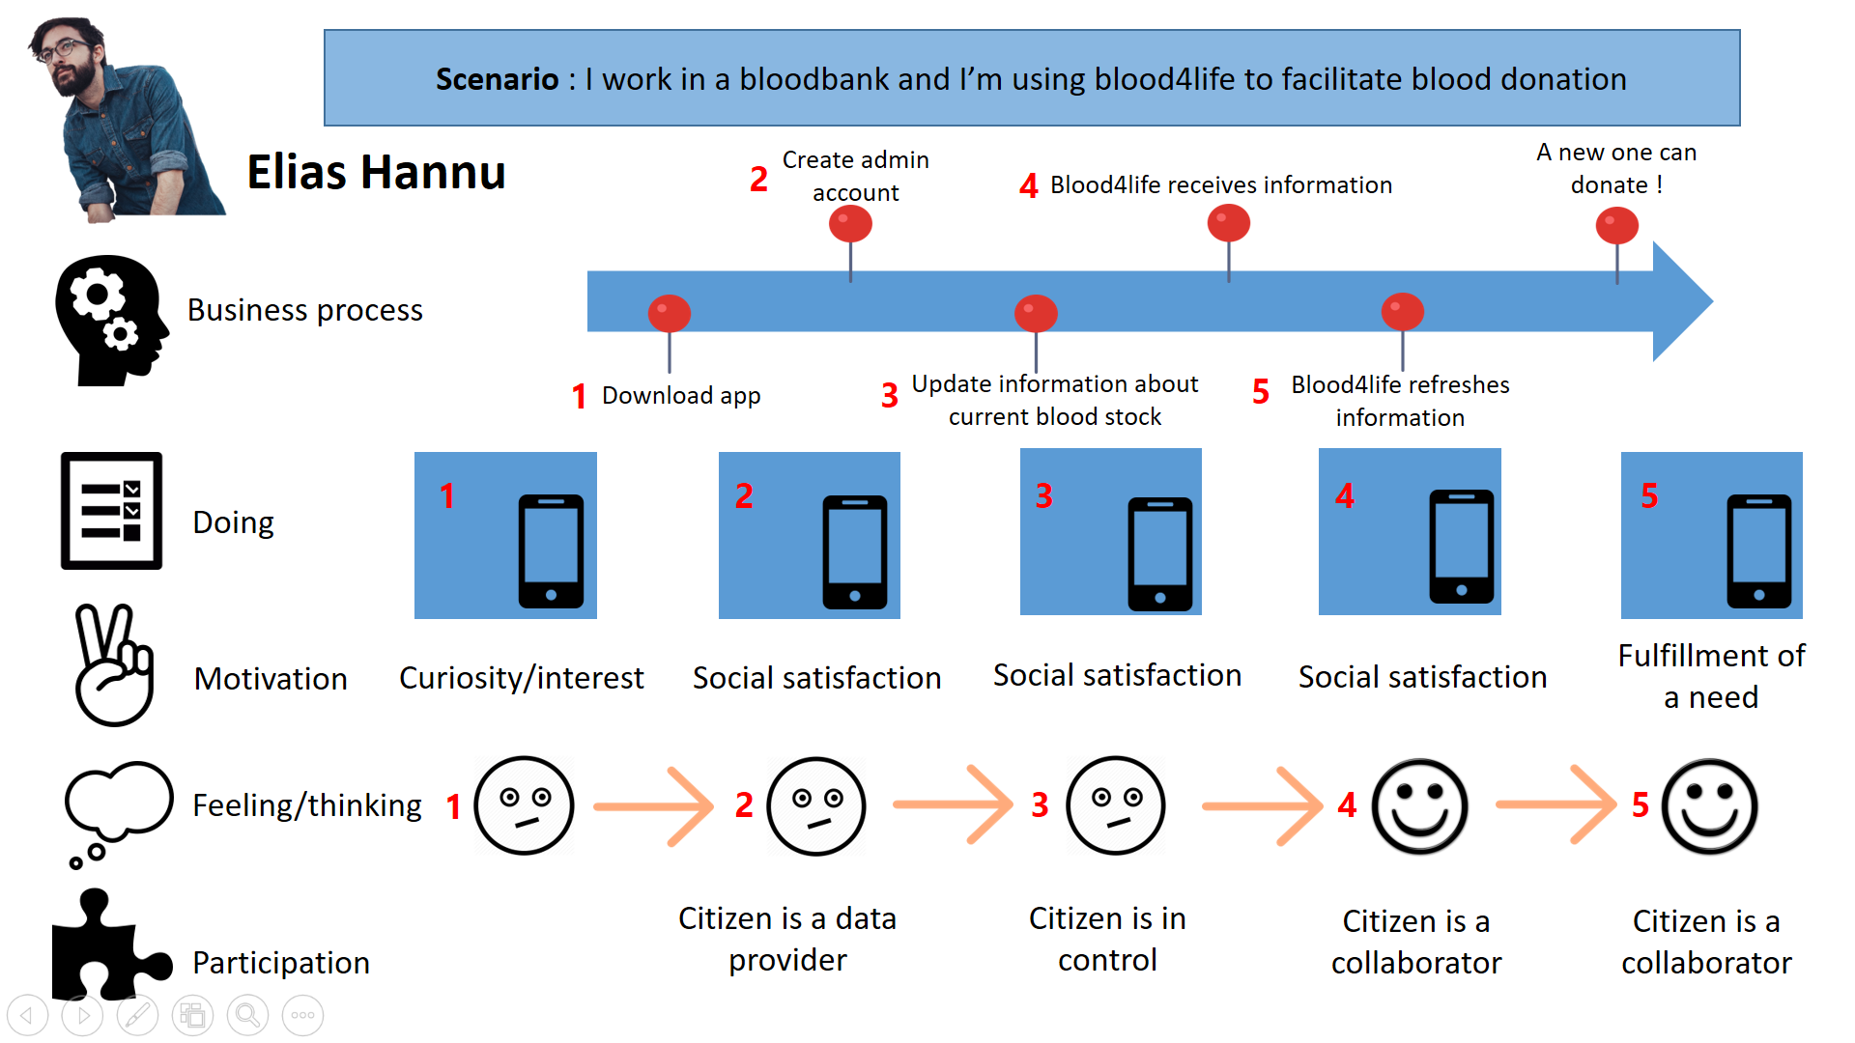
Journey Maps!

Slide 17
Development
3

Slide 18
Key Features!
Web Application (Platform Independent)
Blood Barometer
User registers with personal information
Users can schedule, cancel & reschedule appointments
Users will be notified when there is a need for a specific blood group
Admin can manage appointments, update the blood barometer

Slide 19
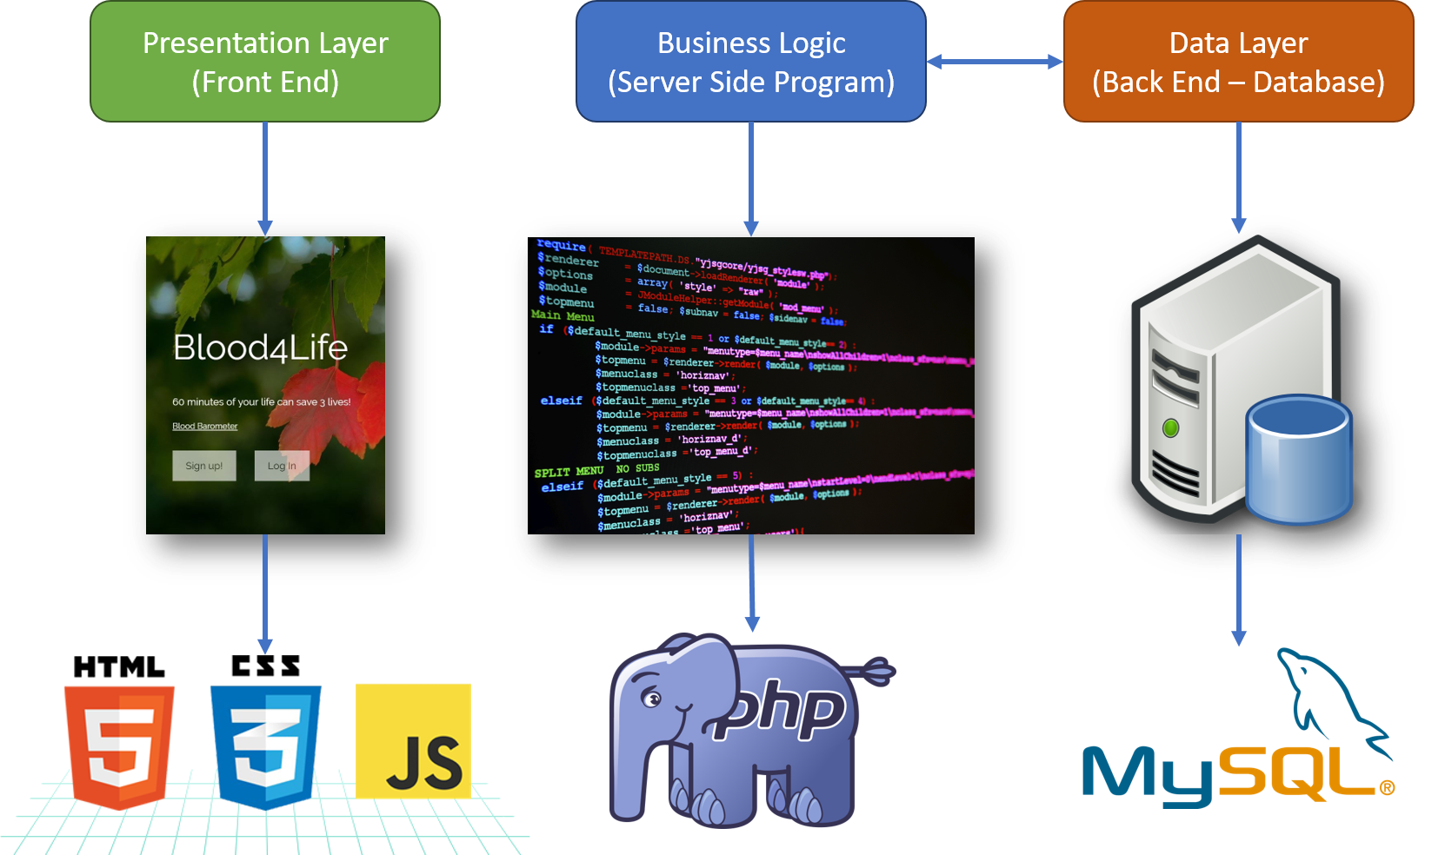
Technical Architecture

Slide 20
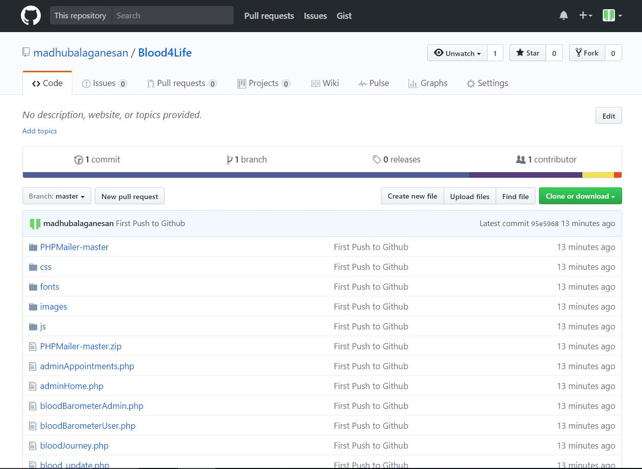
Public Repository
https://github.com/madhubalaganesan/Blood4Life

Slide 21
Demonstration Video Demo https://blood4life.000webhostapp.com/

Slide 22
Testing and Maintenance
4

Slide 23
V & V
Blood4Life
Watch Dog
ISO 25010
Satisfaction
Effectiveness
Context Coverage
Freedom from risk
Efficiency
Validation
Functional requirements
Non functional requirements
Verification
ISO25010 Software Quality Standard
V & V

Slide 24
User Feedback Analysis

Slide 25
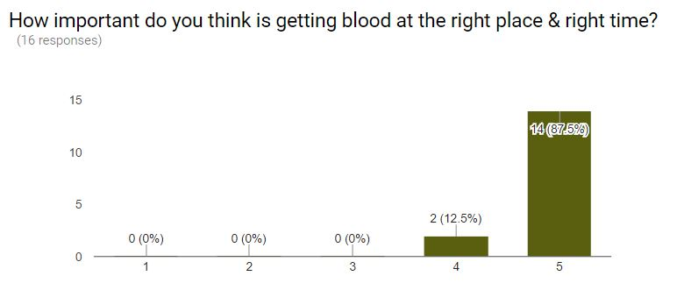
Background Study

Slide 26
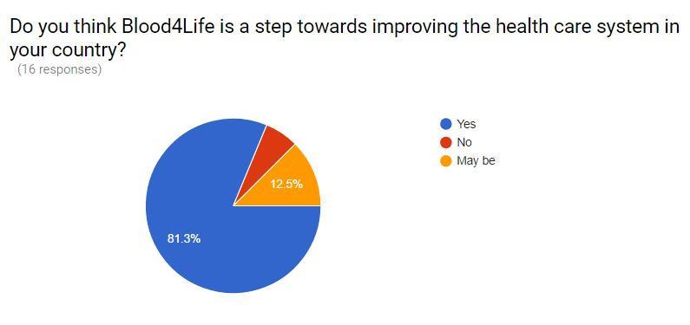
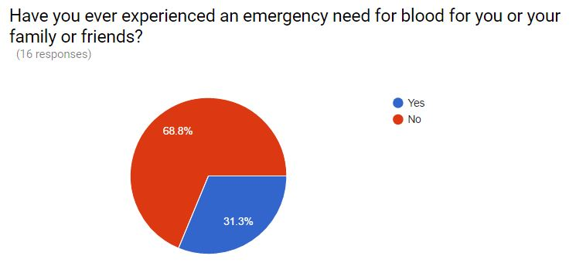
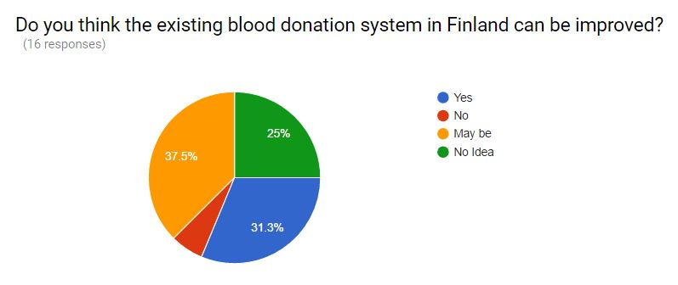
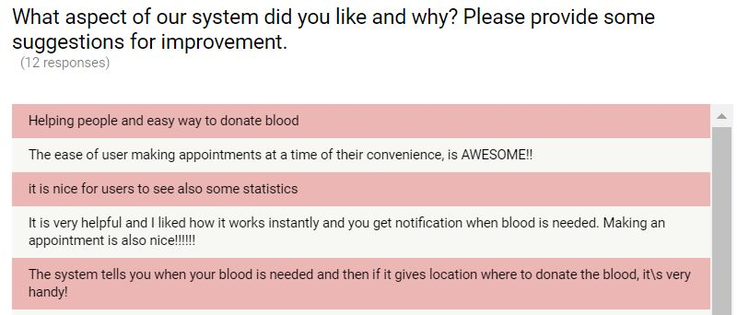
Background Study

Slide 27



Maintenance

Slide 28







Learning!

Slide 29
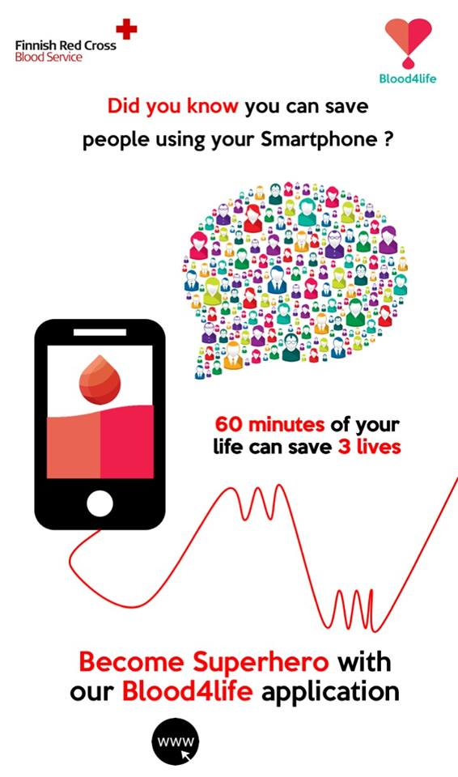
THANKS!

